Slide 1
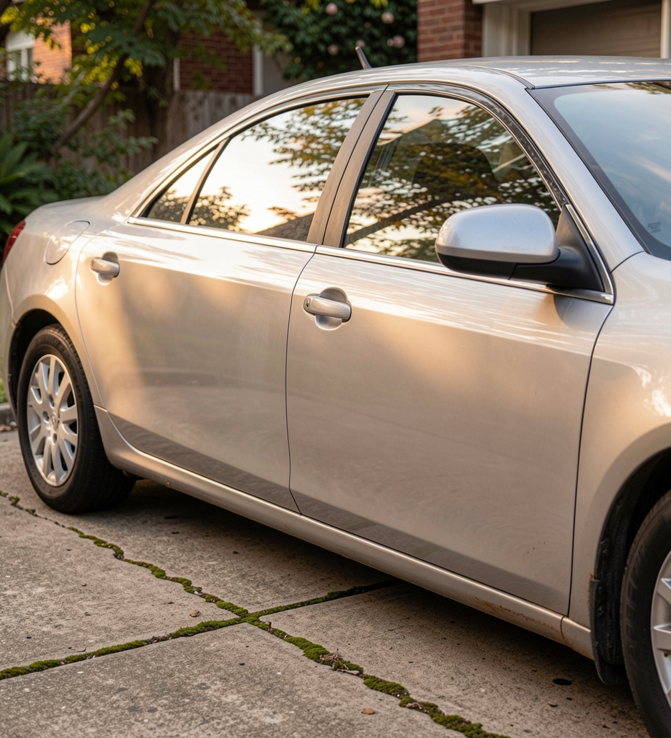
CarDekho Pricing
Depreciation, Value Retention & Regression Modeling

Slide 2
Pricing Standardization
Used-car marketplaces contend with diverse listings across brands, ages, and conditions, making price variation a constant. Inconsistent pricing fuels negotiation friction and longer listing times, eroding buyer and seller confidence. A quantitative pricing framework can standardize valuations, reduce time-to-sale, and boost marketplace efficiency.

Slide 3
Pricing Question
Can listing data explain price variation and yield reliable resale estimates across the market? We examine how factors like age, mileage, and listing attributes drive observed prices, and whether a data-driven model can deliver sensible resale values for a broad marketplace. The goal is to establish a transparent, interpretable link between listing features and price outcomes.

Slide 4
Analytics Pipeline
01
02
03
04
Raw Data
Cleaning
Feature Eng
Exploratory Data Analysis
15,000+ CarDekho listings compiled for baseline analysis.
Handle missing values and apply outlier filters to stabilize signals.
Derive age, age-squared, power per kg, price per km-equivalent.
Assess distributions, correlations, and initial market signals.

Slide 5
Analytics Pipeline
Handle missing values and outlier filters to stabilize signals.
Cleaning
Create age, age-squared, power per kg, price per km-equivalent features.
Feature Eng
Explore distributions, correlations, and potential biases.
EDA
Assess value retention vs 1-year median to quantify depreciation.
Depreciation

Slide 6
Power Drives Price
Power and engine capacity elevate price, while mileage, age, and kilometres driven suppress it.
+0.751
+0.587
-0.306
Maximum Power vs Price correlation
Engine capacity vs Price correlation
Mileage vs Price correlation
-0.241
-0.121
₹10.5L
Vehicle Age vs Price correlation
Km Driven vs Price correlation
Median price for automatic listings (premium vs manual)

Slide 7
Age Drives Depreciation
Across brands, prices decline with vehicle age; the depreciation curve slopes downward as cars get older. Age shows a stronger relationship with price (−0.241) than kilometres driven (−0.121). In cross‑section, age explains more of the resale variation than mileage.
Kilometres driven contributes to price but less effectively once age is accounted for. While mileage matters, it is a weaker predictor of price than age in cross‑sectional data, and nonlinearities do not overturn the primacy of age.
Age is the dominant depreciation signal in cross‑sectional pricing.

Slide 8
Best Fit: GB
Nonlinear models outperform linear; Gradient Boosting leads on R² and RMSE, Random Forest delivers the lowest MAE.
0.5277
₹2.19L
₹7.53L
R² — Linear Regression
MAE — Linear Regression
RMSE — Linear Regression
0.7083
₹1.57L
₹5.92L
R² — Log Linear Regression
MAE — Log Linear Regression
RMSE — Log Linear Regression},{

Slide 9
Model Fit
Nonlinear models outperform linear; Gradient Boosting offers the best overall fit, while Random Forest yields the lowest MAE.
0.8086
₹4.80L
₹1.29L
R² — Gradient Boosting (GB)
RMSE — GB
MAE — GB
0.7670
₹5.29L
₹1.16L
R² — Random Forest (RF)
RMSE — RF
MAE — RF (lowest MAE)

Slide 10
Limitations & Actions
The cross-sectional design hides vehicle-level depreciation over time, and listing biases can distort pricing signals. Prioritize age, power, engine, brand, and transmission; avoid kilometres without age context, and monitor brand residuals. Use nonlinear models (GBM/RF) in production, surface model uncertainty in dashboards, and deploy brand-specific models for high-volume makers.

Slide 11
Next Priorities
- Emphasize listing-level attributes (power, engine, age, transmission) in pricing models and seller guidance.
- Nonlinear ML models deliver materially better price estimates than linear models.
- Be mindful of limitations: cross-sectional design (no longitudinal depreciation), potential listing bias, and residual brand-specific errors that warrant brand-level monitoring or models.

Slide 12
Thanks!
Do you have any questions?
youremail@freepik.com
+91 620 421 838
yourcompany.com
Please keep this slide for attribution

